Slide 1
Spyware Detection for Audio & Video Feed in Android
Chowdhury Md Rakin Haider, 0416052013
Md. Touhiduzzaman, 0416052040

Slide 2
Overview
Area of Threat
WebRTC: How does it work?
The Threat
Standard WebRTC Call
Suspicious calling-way for the Spyware
Existing Researches
DroidAPIMiner
Droid-Sec
DREBIN
Dissecting Android Malware
Behavioral Malware Detection Approaches for Android
Our Prompted Metrics For Detection
Battery Consumption
Service Invocation
Hardware Access (esp. camera and microphone)
Frequency detection
User reporting

Slide 3









Area of Threat

Slide 4
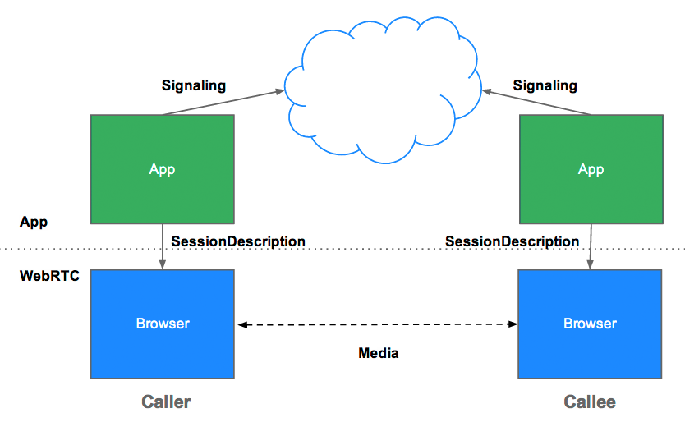
Area of Threat
WebRTC : How does it work?
Caller : App / Web-browser agent request session
Callee : Notified through signalling
Peer-to-peer (P2P) media session is established
No server over-head during the media (audio/video) communication

Slide 5
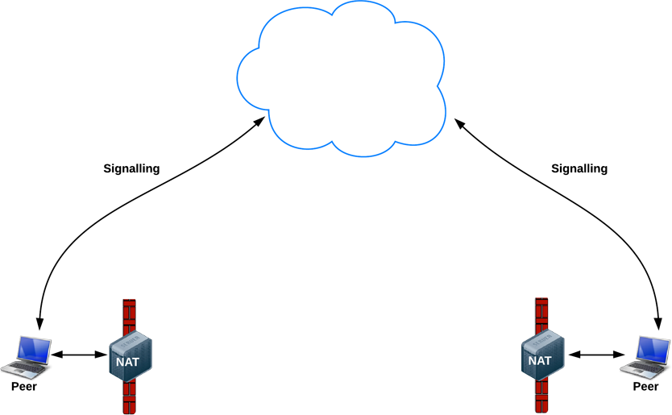
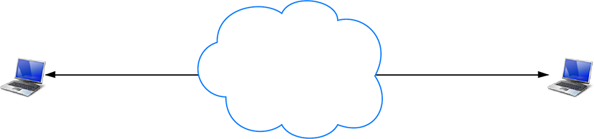
Area of Threat
WebRTC : How does it work?
P2P connection is not directly allowed over multiple routing scenarios (internet, GSM etc.)
P2P session
P2P signaling
VS.
Figure: Expected P2P Connection (A world without NATs and firewalls)
Figure: Real-world P2P Connection Barrier

Slide 6
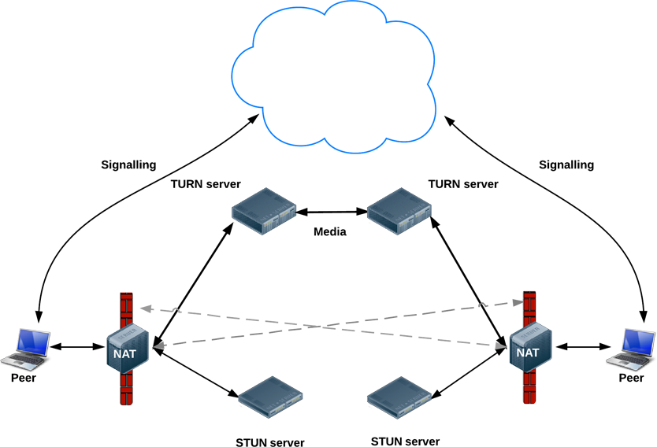
Area of Threat
WebRTC : How does it work?
Caller (phone app. or browser-agent):
Hits signaling server
Attempts to initiate session through STUN server (direct P2P connection)
TURN server initiates the session with media footprint on STUN failure
Callee (phone app or browser-agent):
Notified through signaling
Joins the P2P session
No server over-head during the media (audio/video) communication for STUN success, but media footprint during TURN server’s takeover
Figure: Full WebRTC Connection Scenario : STUN, TURN and Signaling Servers

Slide 7
The Threat
Hacker Device Request
PUSH Request
Start a Service in the Target Android Device through the Spyware
WebRTC Technology

Slide 8


The Threat
Call
Accept
Standard Calling (Audio / Video) Scenario

Slide 9
The Threat
Hacker Requests Auto Reception
What if no accept / reject window is shown?

Slide 10
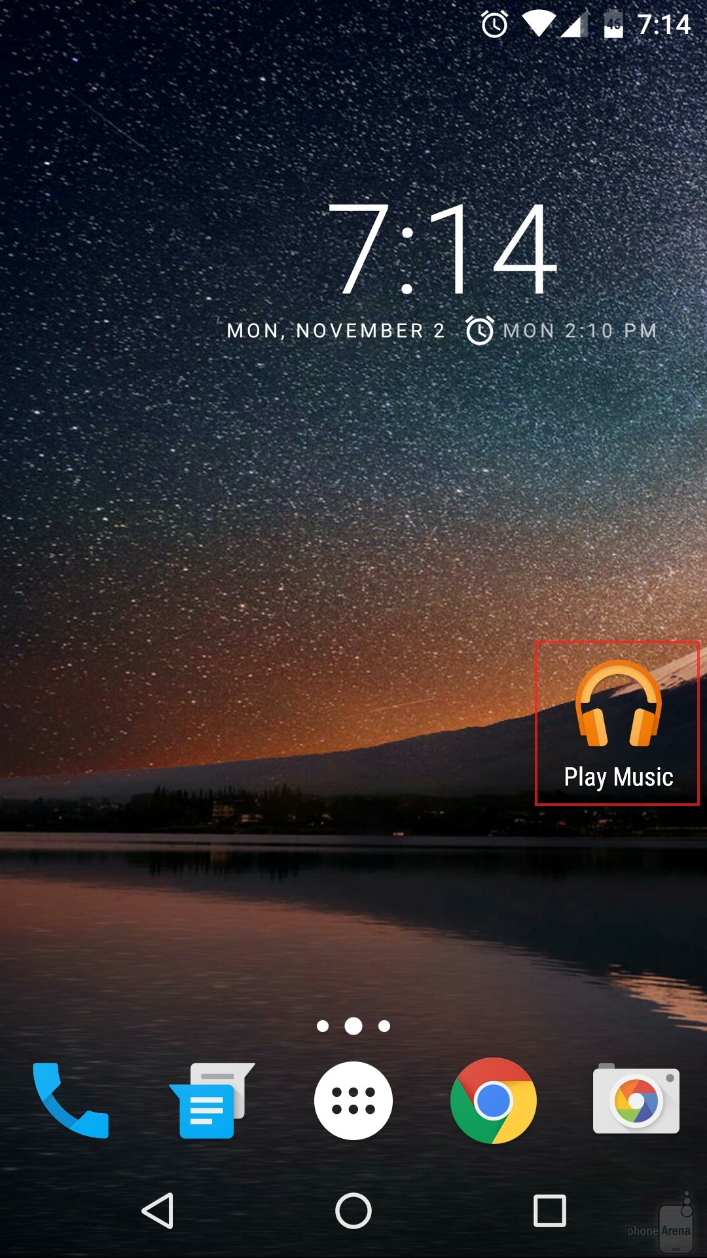
The Threat
Attacker
Victim
Hidden Reception Request
What if the call is automatically established in background using invisible activity or service?

Slide 11
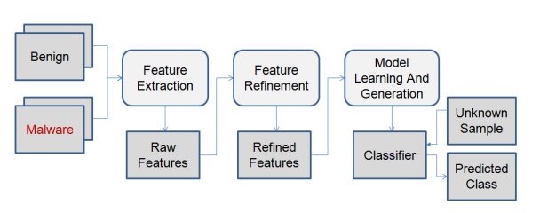
Existing Researches
DroidAPIMiner: Mining API-Level Features for Robust Malware Detection in Android
Yousra Aafer, Wenliang Du, and Heng Yin
Feature Extraction and Refinement
Extraction of Dangerous APIs
Extraction of Package Level Info
Extraction of APIs Parameters
Insights in API-Level Malware Behavior
Application-specific resources APIs (Context & Intents)
Android framework resources APIs
DVM related resources APIs
System resources APIs
Utilities APIs
Permission Based Model

Slide 12
Existing Researches
DroidAPIMiner: Mining API-Level Features for Robust Malware Detection in Android
Yousra Aafer, Wenliang Du, and Heng Yin
Classification and Evaluation
ID3 DT
KNN
C4.5
SVM

Slide 13
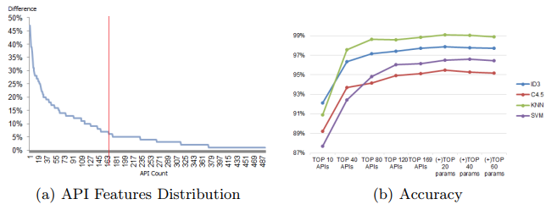
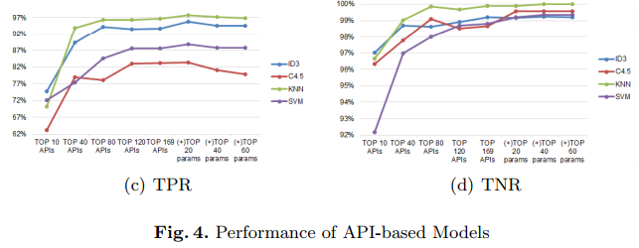

Existing Researches
DroidAPIMiner: Mining API-Level Features for Robust Malware Detection in Android
Yousra Aafer, Wenliang Du, and Heng Yin

Slide 14
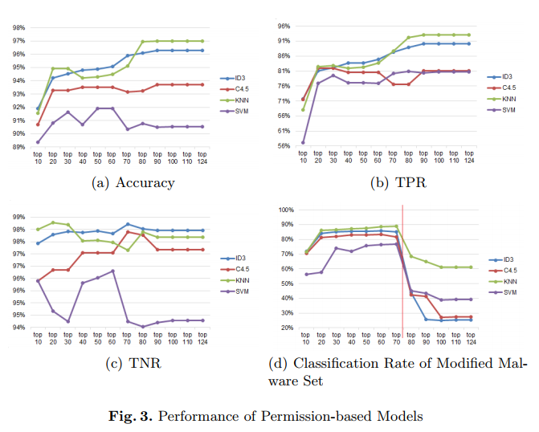
Existing Researches
DroidAPIMiner: Mining API-Level Features for Robust Malware Detection in Android
Yousra Aafer, Wenliang Du, and Heng Yin

Slide 15
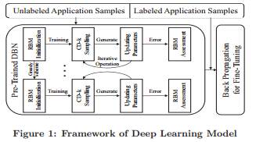
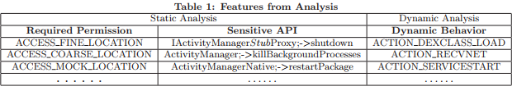
Existing Researches
2. Droid-Sec: Deep Learning in Android Malware Detection Zhenlong Yuan, Yongqiang Lu, Zhaoguo Wangand Yibo Xue

Slide 16
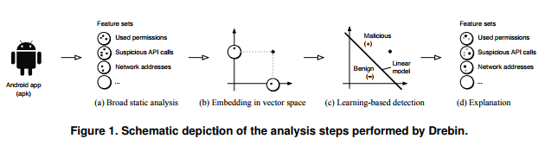
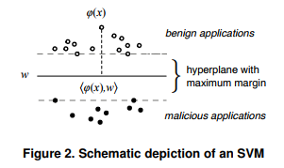
Existing Researches
3. DREBIN: Effective and Explainable Detection of Android Malware in Your Pocket
Daniel Arp1 , Michael Spreitzenbarth2 , Malte Hubner ¨ 1 , Hugo Gascon1 , Konrad Rieck1

Slide 17
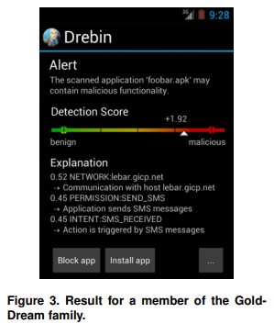
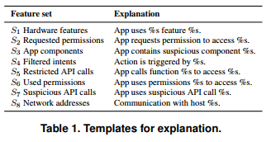
Existing Researches
3. DREBIN: Effective and Explainable Detection of Android Malware in Your Pocket
Daniel Arp1 , Michael Spreitzenbarth2 , Malte Hubner ¨ 1 , Hugo Gascon1 , Konrad Rieck1

Slide 18
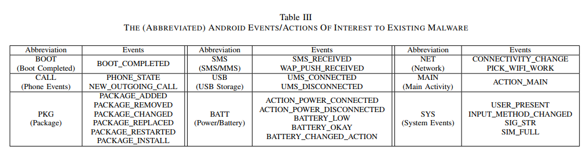
Existing Researches
4. Dissecting Android Malware: Characterization and Evolution
Yajin Zhou, Xuxian Jiang Department of Computer Science North Carolina State University

Slide 19
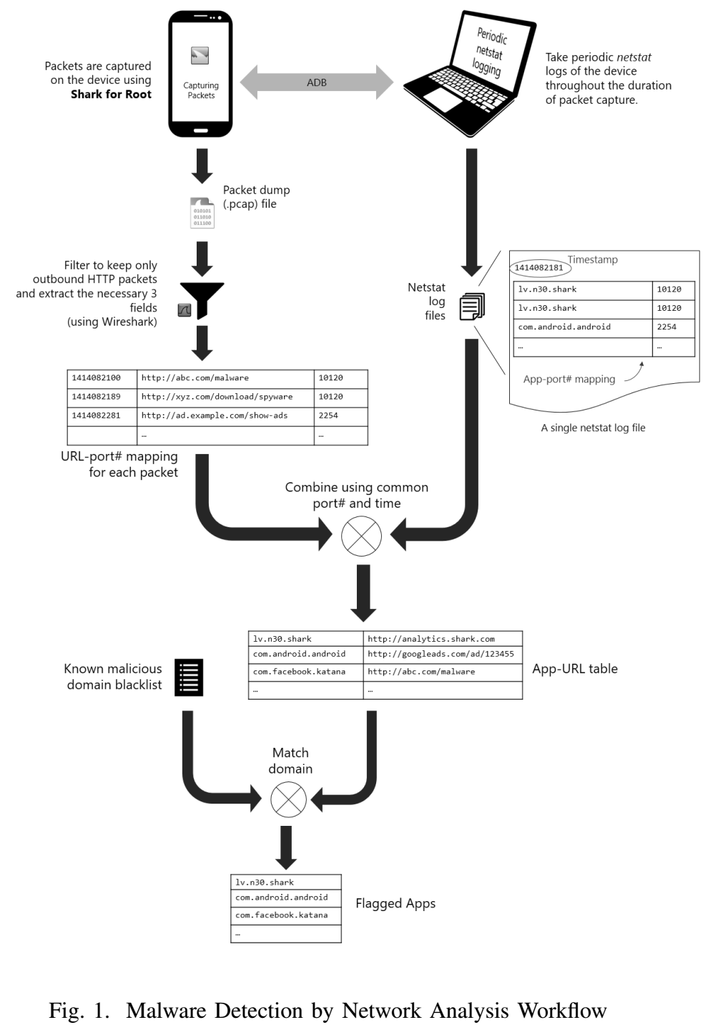
Existing Researches
5. Behavioral Malware Detection Approaches for Android
Mohammad Rakib Amin
Mehedee Zaman
Md. Shohrab Hossain
Mohammed Atiquzzaman

Slide 20
Existing Researches
5. Behavioral Malware Detection Approaches for Android
Mohammad Rakib Amin
Mehedee Zaman
Md. Shohrab Hossain
Mohammed Atiquzzaman

Slide 21

Existing Researches
5. Behavioral Malware Detection Approaches for Android
Mohammad Rakib Amin
Mehedee Zaman
Md. Shohrab Hossain
Mohammed Atiquzzaman

Slide 22
Our Prompted Metrics For Detection
Battery Consumption
Service Invocation
Hardware Access (esp. camera and microphone)
Frequency detection
User reporting

Slide 23
Our Prompted Metrics For Detection
Battery Consumption
Continuous camera access and media-streaming need more battery consumption.
Standard WebRTC app visibly drains the battery, but any spy-cam app will do it invisibly.
Battery consumption rate from service should be close to zero, but for such spywares - it will be a lot higher than the average.

Slide 24
Our Prompted Metrics For Detection
Battery Consumption
Service Invocation
Spontaneous PUSH service reception for such spywares
Will not show any UI on such service activation
Will access camera and/or microphone from such malicious services

Slide 25
Our Prompted Metrics For Detection
Battery Consumption
Service Invocation
Hardware Access (esp. camera and microphone)
Access without user prompts
Stream audio and/or video media online
Misusing the access-permissions (both install-time & run-time) for specific hardware

Slide 26
Our Prompted Metrics For Detection
Battery Consumption
Service Invocation
Hardware Access (esp. camera and microphone)
Frequency detection
Frequently getting PUSH messages through standard GCM (Google Cloud Messaging) or FCM (Firebase Cloud Messaging) or any other standard PUSH services
No user invocation in such frequent launches

Slide 27
Our Prompted Metrics For Detection
Battery Consumption
Service Invocation
Hardware Access (esp. camera and microphone)
Frequency detection
User reporting
The proposed metrics will index the installed apps
User will finally identify such spyware from the presented report so that any such positively intended apps (like remote monitoring on kids or elderly people) can be white-listed

Slide 28
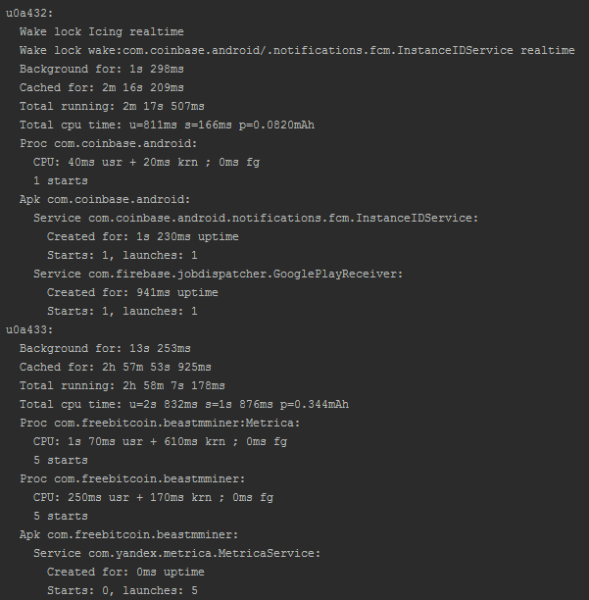
Metric Data Collection

Slide 29
Metric Data Collection
Sampling data in 5 minute interval
Process Name | Bytes Sent | Bytes Received
Skype | 159219 | 74449
Chrome | 73317 | 68002
Google Keep | 66046 | 59018

Slide 30
Metric Data Collection
Sampling data in 5 minute interval
Process Name | Bytes Sent | Bytes Received
Skype | 159219 | 74449
Chrome | 73317 | 68002
Google Keep | 66046 | 59018

Slide 31

Thank You

